Slide 1
AUST Programming Class #1
Topic: I/O

Slide 2
What Is Test Case?
Some times you make an experiment and you test that experiment with different inputs several times.
You want to be sure that your program is valid for running every types of input

Slide 3
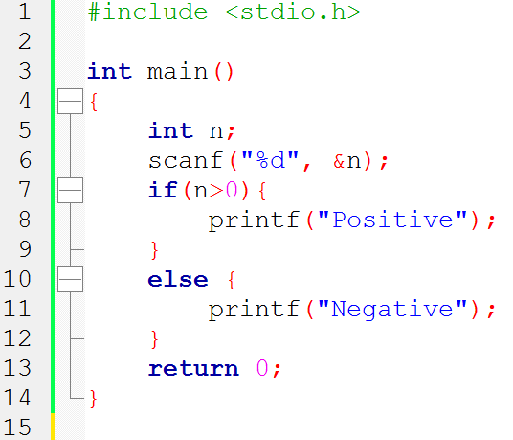
Example
Problem: Take an integer as input and show if the number is positive or negative or zero
Wrong Code:

Slide 4
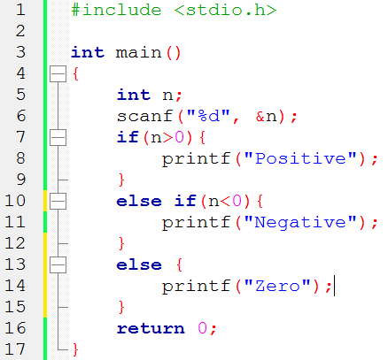
Valid Code:

Slide 5
Types of Taking Input in Problems
Test Case Input
End Of File
Special Case

Slide 6
Input with Test Case
The problem set asks you to take the input of “number of test cases”.
Then for each test case you have to do rest of the works repeatedly.

Slide 7
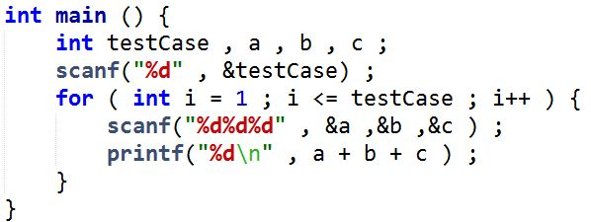
Test Case
Example: Write a program to take three numbers as input. Your output should be the sum of the three numbers.

Slide 8
End Of File
There is no limit of taking inputs.
You will have to detect “end of file” cases when you don’t see any other terminating condition.

Slide 9
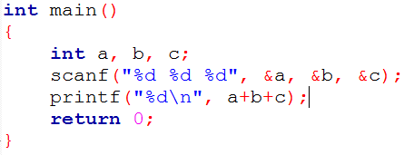
Example
Problem: Take three integers as input and show the sum of them as output. Program will be terminated by end of file
Wrong Code:

Slide 10
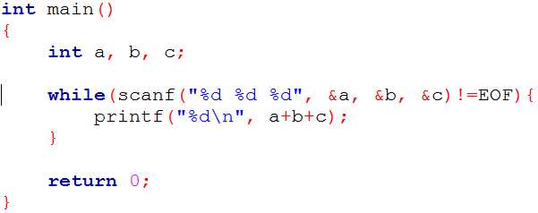
End Of File
Solution of the example of test case problem in End Of File Style
To stop taking input: CTRL + Z

Slide 11
Special Case
The program may terminate for a specific set of input.
If That particular input or input combination is given, then the program will terminate.

Slide 12
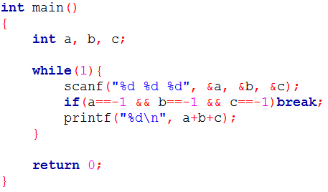
Special Case
Example: Take three as numbers as input and output there sum. Program ends if all the inputs are -1.

Slide 13
Output Showing
Showing Test Case
With out showing Test Case

Slide 14
Showing Test Case
Problem: Sum of three integers
Sample Input:
1 2 3
5 2 7
8 5 9
Sample Output:
Case 1: 6
Case 2: 14
Case 3: 22

Slide 15
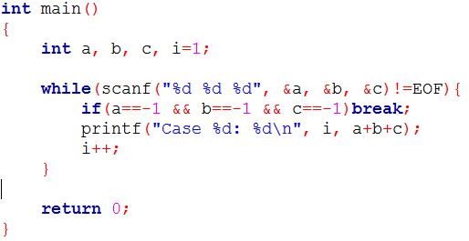
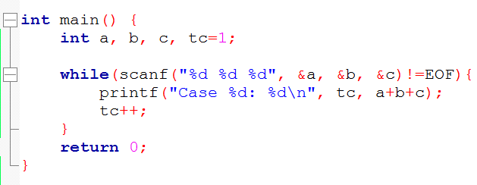
Code for Showing Test Case

Slide 16
Without Showing Test Case
Problem: Sum of three integers
Sample Input:
1 2 3
5 2 7
8 5 9
Sample Output:
6
14
22

Slide 17
Code for without Showing Test Case

Slide 18
Cautious
Take the input exactly as the sample input is given
Show the output exactly as the sample output is given
Never forget to print a new line (‘\n’) at the end of each case. Otherwise you will get presentation error
Just do it exactly they how they tell you to do

Slide 19
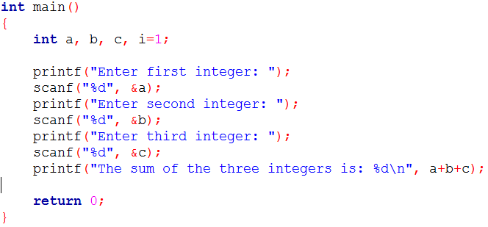
Never try this:
Problem: Sum of three integers

Slide 20
Verdict of Online Judges
AC – Accepted
WA – Wrong Answer
TLE – Time Limit Exceeded
RTE – Runtime Error
PE - Presentation Error

Slide 21
Q/A

Slide 22
Happy Coding!! :)

